Slide 1


Artificial Intelligence 303105307
Computer Science & Engineering

Slide 2


CHAPTER-3
Knowledge Representation
Topic-3.1
Knowledge Representation
Representation and Mappings

Slide 3
Contents
Basic concepts of knowledge representation
Different Types of Knowledge
Representation Requirements
Cycle of Knowledge Representation in AI
Techniques of Knowledge Representation in AI
Representations and Mappings

Slide 4
Basic concepts
Knowledge Representation in AI describes the representation of knowledge. Basically, it is a study of how the beliefs, intentions, and judgments of an intelligent agent can be expressed suitably for automated reasoning. One of the primary purposes of Knowledge Representation includes modelling intelligent behaviour for an agent.
The different kinds of knowledge that need to be represented in AI include:
Objects
Events
Performance
Facts
Meta-Knowledge
Knowledge-base

Slide 5
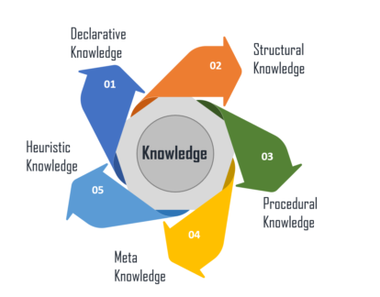
Different Types of Knowledge
There are 5 types of Knowledge such as:
There are 5 types of Knowledge such as:

Slide 6
Different Types of Knowledge
Declarative Knowledge – It includes concepts, facts, and objects and expressed in a declarative sentence.
Structural Knowledge – It is a basic problem-solving knowledge that describes the relationship between concepts and objects.
Procedural Knowledge – This is responsible for knowing how to do something and includes rules, strategies, procedures, etc.
Meta Knowledge – Meta Knowledge defines knowledge about other types of Knowledge.
Heuristic Knowledge – This represents some expert knowledge in the field or subject.

Slide 7
Representation Requirements
A good knowledge representation system must have properties such as:
Representational Accuracy: It should represent all kinds of required knowledge.
Inferential Adequacy: It should be able to manipulate the representational structures to produce new knowledge corresponding to the existing structure.
Inferential Efficiency: The ability to direct the inferential knowledge mechanism into the most productive directions by storing appropriate guides.
Acquisitional efficiency: The ability to acquire new knowledge easily using automatic methods.

Slide 8

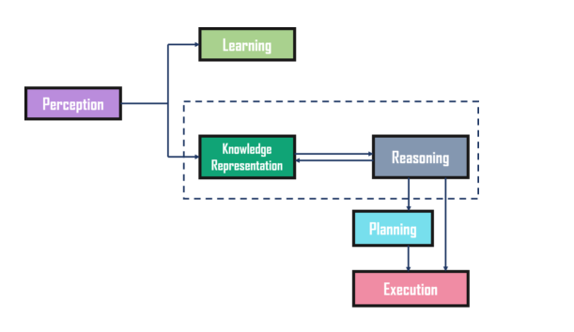
Cycle of Knowledge Representation in AI
There are 5 types of Knowledge such as:

Slide 9
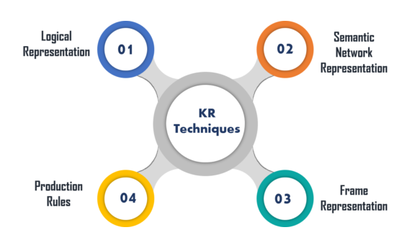
Techniques of Knowledge Representation in AI

Slide 10
Techniques of Knowledge Representation in AI
Logical Representation
Logical representation is a language with some definite rules which deal with propositions and has no ambiguity in representation. It represents a conclusion based on various conditions and lays down some important communication rules. Also, it consists of precisely defined syntax and semantics which supports the sound inference. Each sentence can be translated into logics using syntax and semantics.
Syntax | Semantics
It decides how we can construct legal sentences in logic. It determines which symbol we can use in knowledge representation. Also, how to write those symbols. | Semantics are the rules by which we can interpret the sentence in the logic. It assigns a meaning to each sentence.

Slide 11
Techniques of Knowledge Representation in AI
Advantages:
Logical representation helps to perform logical reasoning.
This representation is the basis for the programming languages.
Disadvantages:
Logical representations have some restrictions and are challenging to work with.
This technique may not be very natural, and inference may not be very efficient.

Slide 12
Techniques of Knowledge Representation in AI
Semantic Network Representation
Semantic networks work as an alternative of predicate logic for knowledge representation. In Semantic networks, you can represent your knowledge in the form of graphical networks. This network consists of nodes representing objects and arcs which describe the relationship between those objects. Also, it categorizes the object in different forms and links those objects.
This representation consist of two types of relations:
IS-A relation (Inheritance)
Kind-of-relation

Slide 13
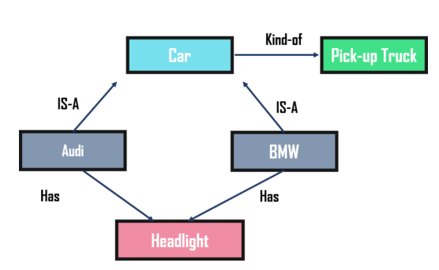
Techniques of Knowledge Representation in AI
This representation consist of two types of relations:
IS-A relation (Inheritance)
Kind-of-relation

Slide 14
Techniques of Knowledge Representation in AI
Advantages:
Semantic networks are a natural representation of knowledge.
Also, it conveys meaning in a transparent manner.
These networks are simple and easy to understand.
Disadvantages:
Semantic networks take more computational time at runtime.
Also, these are inadequate as they do not have any equivalent quantifiers.
These networks are not intelligent and depend on the creator of the system.

Slide 15
Techniques of Knowledge Representation in AI
Frame Representation
A frame is a record like structure that consists of a collection of attributes and values to describe an entity in the world. These are the AI data structure that divides knowledge into substructures by representing stereotypes situations. Basically, it consists of a collection of slots and slot values of any type and size. Slots have names and values which are called facets.

Slide 16
Techniques of Knowledge Representation in AI
Advantages:
It makes the programming easier by grouping the related data.
Frame representation is easy to understand and visualize.
It is very easy to add slots for new attributes and relations.
Also, it is easy to include default data and search for missing values.
Disadvantages:
In frame system inference, the mechanism cannot be easily processed.
The inference mechanism cannot be smoothly proceeded by frame representation.
It has a very generalized approach.

Slide 17
Techniques of Knowledge Representation in AI
Production Rules
In production rules, agent checks for the condition and if the condition exists then production rule fires and corresponding action is carried out. The condition part of the rule determines which rule may be applied to a problem. Whereas, the action part carries out the associated problem-solving steps. This complete process is called a recognize-act cycle.
The production rules system consists of three main parts:
The set of production rules
Working Memory
The recognize-act-cycle

Slide 18
Techniques of Knowledge Representation in AI
Advantages:
The production rules are expressed in natural language.
The production rules are highly modular and can be easily removed or modified.
Disadvantages:
It does not exhibit any learning capabilities and does not store the result of the problem for future uses.
During the execution of the program, many rules may be active. Thus, rule-based production systems are inefficient.

Slide 19
Representations and Mappings
In order to solve complex problems encountered in artificial intelligence, one needs both a large amount of knowledge and some mechanism for manipulating that knowledge to create solutions.
Knowledge and Representation are two distinct entities. They play central but distinguishable roles in the intelligent system.
Knowledge is a description of the world. It determines a system’s competence by what it knows.
Moreover, Representation is the way knowledge is encoded. It defines a system’s performance in doing something.
Different types of knowledge require different kinds of representation.

Slide 20
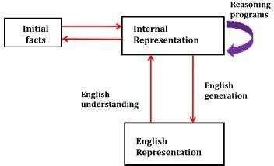
Representations and Mappings
Fig: Mapping between Facts and Representations

Slide 21
Representations and Mappings
The Knowledge Representation models/mechanisms are often based on:
Logic
Rules
Frames
Semantic Net
Knowledge is categorized into two major types:
1. Tacit corresponds to “informal” or “implicit“
Exists within a human being;
It is embodied.
Difficult to articulate formally.
Difficult to communicate or share.
Moreover, Hard to steal or copy.
Drawn from experience, action, subjective insight

Slide 22
Representations and Mappings
2. Explicit formal type of knowledge, Explicit
Explicit knowledge
Exists outside a human being;
It is embedded.
Can be articulated formally.
Also, Can be shared, copied, processed and stored.
So, Easy to steal or copy
Drawn from the artifact of some type as a principle, procedure, process, concepts.

Slide 23
Representations and Mappings
A variety of ways of representing knowledge have been exploited in AI programs. There are two different kinds of entities, we are dealing with.
Facts: Truth in some relevant world. Things we want to represent.
Also, Representation of facts in some chosen formalism. Things we will actually be able to manipulate.
These entities structured at two levels:
The knowledge level, at which facts described.
Moreover, The symbol level, at which representation of objects defined in terms of symbols that can manipulate by programs

Slide 24
CHAPTER-3
Knowledge Representation
Topic-3.2
Different Approaches
Issues in Knowledge representation

Slide 25
Contents
Approaches to Knowledge Representation in AI
Issues in Knowledge Representation

Slide 26
Approaches to Knowledge Representation in AI
here are different approaches to knowledge representation such as:
1. Simple Relational Knowledge
It is the simplest way of storing facts which uses the relational method. Here, all the facts about a set of the object are set out systematically in columns. Also, this approach of knowledge representation is famous in database systems where the relationship between different entities is represented. Thus, there is little opportunity for inference.

Slide 27
Approaches to Knowledge Representation in AI
Example:
Name | Age | Emp ID
John | 25 | 100071
Amanda | 23 | 100056
Sam | 27 | 100042
This is an example of representing simple relational knowledge.

Slide 28
Approaches to Knowledge Representation in AI
2. Inheritable Knowledge
In the inheritable knowledge approach, all data must be stored into a hierarchy of classes and should be arranged in a generalized form or a hierarchal manner. Also, this approach contains inheritable knowledge which shows a relation between instance and class, and it is called instance relation. In this approach, objects and values are represented in Boxed nodes.

Slide 29
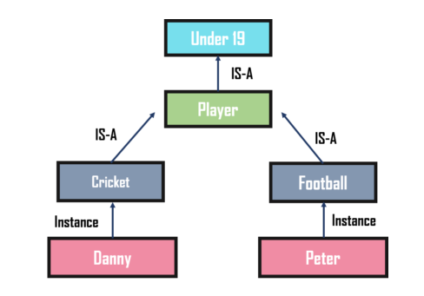
Approaches to Knowledge Representation in AI
Example:

Slide 30
Approaches to Knowledge Representation in AI
3. Inferential Knowledge
The inferential knowledge approach represents knowledge in the form of formal logic. Thus, it can be used to derive more facts. Also, it guarantees correctness.
Example:
Statement 1: John is a cricketer.
Statement 2: All cricketers are athletes.
Then it can be represented as;
Cricketer(John)
∀x = Cricketer (x) ———-> Athelete (x)s
These were some of the approaches to knowledge representation in AI along with examples. With this, we have come to the end of our article. I hope you understood what is Knowledge Representation in AI and its different types.

Slide 31
Issues in Knowledge Representation
The fundamental goal of knowledge Representation is to facilitate inference (conclusions) from knowledge.
The issues that arise while using KR techniques are many. Some of these are explained below.
Important Attributed:
Any attribute of objects so basic that they occur in almost every problem domain?
There are two attributed “instance” and “isa”, that are general significance. These attributes are important because they support property inheritance.

Slide 32
Issues in Knowledge Representation
Relationship among attributes:
Any important relationship that exists among object attributed?
The attributes we use to describe objects are themselves entities that we represent.
The relationship between the attributes of an object, independent of specific knowledge they encode, may hold properties like:
Inverse — This is about consistency check, while a value is added to one attribute. The entities are related to each other in many different ways.

Slide 33
Issues in Knowledge Representation
Existence in an isa hierarchy —
This is about generalization-specification, like, classes of objects and specialized subsets of those classes, there are attributes and specialization of attributes.
For example, the attribute height is a specialization of general attribute physical-size which is, in turn, a specialization of physical-attribute.
These generalization-specialization relationships are important for attributes because they support inheritance.

Slide 34
Issues in Knowledge Representation
Technique for reasoning about values —
This is about reasoning values of attributes not given explicitly.
Several kinds of information are used in reasoning, like, height: must be in a unit of length, Age: of a person cannot be greater than the age of person’s parents.
The values are often specified when a knowledge base is created.

Slide 35
Issues in Knowledge Representation
Single valued attributes —
This is about a specific attribute that is guaranteed to take a unique value.
For example, a baseball player can at time have only a single height and be a member of only one team.
KR systems take different approaches to provide support for single valued attributes.

Slide 36
Issues in Knowledge Representation
Choosing Granularity:
At what level of detail should the knowledge be represented?
Regardless of the KR formalism, it is necessary to know:
At what level should the knowledge be represented and what are the primitives?
Should there be a small number or should there be a large number of low-level primitives or High-level facts.
High-level facts may not be adequate for inference while Low-level primitives may require a lot of storage.

Slide 37
Issues in Knowledge Representation
Example of Granularity:
Suppose we are interested in following facts:
John spotted Sue.
This could be represented as Spotted (agent(John),object (Sue))
Such a representation would make it easy to answer questions such are:
Who spotted Sue?
Suppose we want to know:
Did John see Sue?
Given only one fact, we cannot discover that answer.
We can add other facts, such as
Spotted(x, y) -> saw(x, y)
We can now infer the answer to the question.

Slide 38
Issues in Knowledge Representation
Set of objects:
How should sets of objects be represented?
There are certain properties of objects that are true as member of a set but not as individual;
Example: Consider the assertion made in the sentences:
“there are more sheep than people in Australia”, and
“English speakers can be found all over the world.”
To describe these facts, the only way is to attach assertion to the sets representing people, sheep, and English.

Slide 39
Issues in Knowledge Representation
The reason to represent sets of objects is: if a property is true for all or most elements of a set, then it is more efficient to associate it once with the set rather than to associate it explicitly with every elements of the set.
This is done,
in logical representation through the use of universal quantifier, and
in hierarchical structure where node represent sets and inheritance propagate set level assertion down to individual.

Slide 40
Issues in Knowledge Representation
Finding Right structure:
Given a large amount of knowledge stored in a database, how can relevant parts are accessed when they are needed?
This is about access to right structure for describing a particular situation.
This requires, selecting an initial structure and then revising the choice.

Slide 41
Issues in Knowledge Representation
While doing so, it is necessary to solve following problems:
How to perform an initial selection of the most appropriate structure.
How to fill in appropriate details from the current situations.
How to find a better structure if the one chosen initially turns out not to be appropriate.
What to do if none of the available structures is appropriate.
When to create and remember a new structure.

Slide 42
Artificial Intelligence 303105307
Computer Science & Engineering

Slide 43
CHAPTER-3
Knowledge Representation
Topic-3.3
Predicate Logic
Representation Simple Facts in Logic

Slide 44
Contents
Predicate Logic
Use of Predicate Logic
Representing Simple Facts in Logic
Examples to Representation of Simple Facts in Logic

Slide 45
Predicate Logic
Predicate logic
First-order Predicate logic (FOPL) models the world in terms of
Objects, which are things with individual identities
Properties of objects that distinguish them from other objects
Relations that hold among sets of objects
Functions, which are a subset of relations where there is only one “value” for any given “input”
First-order Predicate logic (FOPL) provides
Constants: a, b, dog33. Name a specific object.
Variables: X, Y. Refer to an object without naming it.
Functions: Mapping from objects to objects.
Terms: Refer to objects
Atomic Sentences: in(dad-of(X), food6) Can be true or false, Correspond to propositional symbols P, Q.

Slide 46
Predicate Logic
But propositional logic fails to capture the relationship between an individual being a man and that individual being a mortal.
How can these sentences be represented so that we can infer the third sentence from the first two?
Also, Propositional logic commits only to the existence of facts that may or may not be the case in the world being represented.
Moreover, It has a simple syntax and simple semantics. It suffices to illustrate the process of inference.
Propositional logic quickly becomes impractical, even for very small worlds.

Slide 47
Predicate Logic
But propositional logic fails to capture the relationship between an individual being a man and that individual being a mortal.
How can these sentences be represented so that we can infer the third sentence from the first two?
Also, Propositional logic commits only to the existence of facts that may or may not be the case in the world being represented.
Moreover, It has a simple syntax and simple semantics. It suffices to illustrate the process of inference.
Propositional logic quickly becomes impractical, even for very small worlds.

Slide 48
Use of Predicate Logic
Logic
Logic is concerned with the truth of statements about the world. Generally each statement is either TRUE or FALSE.
Logic includes :Syntax , Semantics and Inference Procedure.
Syntax :
Specifies the symbols in the language about how they can be co mbined to form sentences. The facts about the world are repre sented as sentences in logic.

Slide 49
Use of Predicate Logic
Semantic :
Specifies how to assign a truth value to a sentence based on its meaning in the world.
It Specifies what facts a sentence refers to.
A fact is a claim about the world, and it may be TRUE or FALSE.
Inference Procedure :
Specifies methods for computing new sentences from the existing sentences

Slide 50
Representing Simple Facts in Logic
Using propositional logic
–Real-world facts are represented as logical propositions written as well-formed formulas (wff’s)
–Example 1:
It is raining | RAINING
It is sunny | SUNNY
It is Windy | WINDY
If it is raining, then it is not sunny | RAINING → ¬SUNNY

Slide 51
Representing Simple Facts in Logic
Example 2:
Socrates is a man | SOCRATESMAN
Plato is a man | PLATOMAN
All men are mortal | MORTALMAN
=> Since the assertions are separate, it is not possible to dra w any conclusion about similarities between Socrates and Pl ato.

Slide 52
Representing Simple Facts in Logic
It would be much better to represent these facts as
Socrates is a man | man(socrates)
Plato is a man | man(plato)
All men are mortal | mortalman
This fails to capture the relationship between any individual being a man and that individual being a mortal.
Therefore it is necessary to move to first order predicate logic as a way of representing knowledge because it permits representation o f things that cannot reasonably be represented in prepositional logi c.
In predicate logic, real world facts are represented as statements written as well-formed formula (wff’s)

Slide 53
Examples to Representation of Simple Facts in Logic
Representation of Simple Facts in
Propositional logic is useful because it is simple to deal with and a decision procedure for it exists.
Also, In order to draw conclusions, facts are represented in a more convenient way as,
Marcus is a man.
man(Marcus)
2. Plato is a man.
man(Plato)
3. All men are mortal.
mortal(men)

Slide 54
Examples to Representation of Simple Facts in Logic
A well-formed formula (wff) is a sentence containing no “free” variables. So, That is, all variables are “bound” by universal or existential quantifiers.
(∀x)P(x, y) has x bound as a universally quantified variable, but y is free.
Quantifiers
Universal quantification
(∀x)P(x) means that P holds for all values of x in the domain associated with that variable
E.g., (∀x) dolphin(x) → mammal(x)
Existential quantification
(∃ x)P(x) means that P holds for some value of x in the domain associated with that variable
E.g., (∃ x) mammal(x) 𝖠 lays-eggs(x)

Slide 55
Examples to Representation of Simple Facts in Logic Cont..
Also, Consider the following example that shows the use of predicate logic as a way of representing knowledge.
Marcus was a man.
Marcus was a Pompeian.
All Pompeians were Romans.
Caesar was a ruler.
Also, All Pompeians were either loyal to Caesar or hated him
Everyone is loyal to someone.
People only try to assassinate rulers they are not loyal to.
Marcus tried to assassinate Caesar.

Slide 56
Examples to Representation of Simple Facts in Logic
The facts described by these sentences can be represented as a set of well-formed formulas (wffs) as follows:
1.Marcus was a man.
•man(Marcus)
2.Marcus was a Pompeian.
•Pompeian(Marcus)
3.All Pompeians were Romans.
•∀x: Pompeian(x) → Roman(x)
4.Caesar was a ruler.
•ruler(Caesar)
5.All Pompeians were either loyal to Caesar or hated him.
•inclusive-or
•∀x: Roman(x) → loyalto(x, Caesar) ∨ hate(x, Caesar)
•exclusive-or
•∀x: Roman(x) → (loyalto(x, Caesar) 𝖠¬ hate(x, Caesar)) ∨
•(loyalto(x, Caesar) 𝖠 hate(x, Caesar))

Slide 57
Examples to Representation of Simple Facts in Logic
6. Everyone is loyal to someone.
∀x: ∃y: loyalto(x, y)
7. People only try to assassinate rulers they are not loyal to.
∀x: ∀y: person(x) 𝖠 ruler(y) 𝖠 tryassassinate(x, y)
loyalto(x, y)
8. Marcus tried to assassinate Caesar.
tryassassinate(Marcus, Caesar)
Now suppose if we want to use these statements to answer the question: Was Marcus loyal to Caesar?

Slide 58
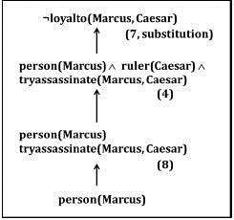
Examples to Representation of Simple Facts in Logic
Also, Now let’s try to produce a formal proof, reasoning backward from the desired goal: Ioyalto (Marcus, Caesar)
In order to prove the goal, we need to use the rules of inference to transform it into another goal (or possibly a set of goals) that can, in turn, transformed, and so on, until there are no unsatisfied goals remaining.
Figure: An attempt to prove loyalto (Marcus, Caesar).

Slide 59
Examples to Representation of Simple Facts in Logic
The problem is that, although we know that Marcus was a man, we do not have any way to conclude from that that Marcus was a person. Also, We need to add the representation of another fact to our system, namely: ∀ man(x) → person(x)
Now we can satisfy the last goal and produce a proof that Marcus was not loyal to Caesar.
Moreover, From this simple example, we see that three important issues must be addressed in the process of converting English sentences into logical statements and then using those statements to deduce new ones:
Many English sentences are ambiguous (for example, 5, 6, and 7 above). Choosing the correct interpretation may be difficult.
Also, There is often a choice of how to represent the knowledge. Simple representations are desirable, but they may exclude certain kinds of reasoning.
Similalry, Even in very simple situations, a set of sentences is unlikely to contain all the information necessary to reason about the topic at hand. In order to be able to use a set of statements effectively. Moreover, It is usually necessary to have access to another set of statements that represent facts that people consider too obvious to mention.

Slide 60
CHAPTER-3
Knowledge Representation
Topic-3.3
Representing Instance and Isa Relationships Representation

Slide 61
Contents
Representing Instance & Isa Relationships
Instances

Slide 62
Instances
An instance is a specific entity that belongs to a more general class. It represents a particular occurrence or member of a class, which can be a person, object, event, etc.
Example- Consider a class called "Animal." An instance of this class could be "Fido," who is a specific dog. In this case, "Fido" is an instance of the class "Dog," which is itself a subclass of the class "Animal."

Slide 63
Instances
Hierarchical Structure
To illustrate how instances fit within a hierarchical structure, here’s a simple example1:
Class: Animal
Subclass: Mammal
Subclass: Dog
Instance: Fido (specific dog)
example2:
Subclass: Cat
Instance: Whiskers (specific cat)
Subclass: Bird
Instance: Tweety (specific bird)

Slide 64
Isa Relationships
In artificial intelligence, particularly in knowledge representation and ontology, "Representing Instance & Isa Relationships" refers to the way entities and their relationships are modeled in a knowledge base. Let's break down these concepts:
Instance Relationships: These relationships define specific instances of a general concept. For example, if you have a general concept "Dog," an instance relationship would be a specific dog, like "Fido."In a structured format, you might see something like:
In a structured format, you might see something like:
Instance: Fido
Type: Dog
This tells the system that Fido is an instance of the broader category "Dog."

Slide 65
Representing Instance & Isa Relationships
Attributes “ IsA ” and “ Instance ” support property inheritance and play important role in knowledge representation.
The ways these two attributes "instance" and "isa", are logically expresse d are shown in the example below :
Example: A simple sentence like "Joe is a musician" Here "is a" (called IsA) is a way of expressing what logically is called a class-instance relationship between the su bjects represented by the terms "Joe" and "musician".
◊ "Joe" is an instance of the class of things called "musician". " Joe" plays the role of instance, "musician" plays the role of class in that sentence.
◊ Note : In such a sentence, while for a human there is no con fusion, but for computers each relationship have to be defined explicitly.

Slide 66
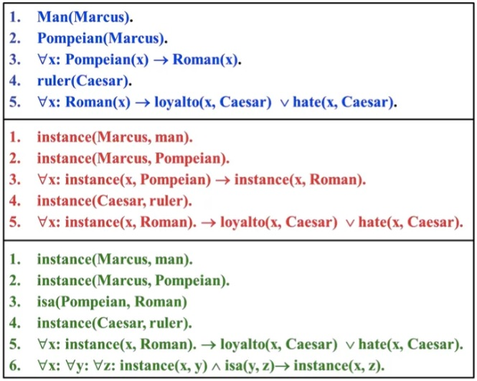
Representing Instance & Isa Relationships
The first part of the figure contains the representations, in which the class membership is represented with unary predicates, each corresponding to a class. Asserting that p(x) is true is equi valent to asserting that X is an instance of p.

Slide 67
Representing Instance & Isa Relationships
The second part uses the instance predicate explicitly. It is a binary one, whose first argument is an object and whose second argument is a class to which the object belongs. The implication rule in statement 3 states that object is an instance of the sub class pompeian then it is an instance of the superclass Roman.
The third part contains representations that use both the instance and isa predicates explicitly. Use of isa simplifies the representation of sentence 3 but requires one additional axiom. It describes how an instance relation and an isa relation combined to derive a new instance relation.

Slide 68
CHAPTER-3
Knowledge Representation
Topic-3.3
Computable Functions
And Predicates, Resolution

Slide 69
Contents
Computable Functions
Predicates
Resolution in AI

Slide 70
Computable Functions
Definition: A computable function is a function for which there exists an algorithm that can compute the function's value for any valid input within a finite amount of time.
Example 1: Arithmetic Function
Python code
def add(a, b):
return a + b
print(add(3, 5))
# Output: 8
Example 2: String Manipulation
python code
def concatenate(str1, str2):
return str1 + str2
print(concatenate("Hello, ", "world!"))
# Output: "Hello, world!“

Slide 71
Computable Functions
Characteristics:
Deterministic: Same input always gives the same output.
Effective Method: There's a clear algorithm to compute it.
Finite Time: Completes in a finite number of steps.
Usage in Logic:
Predicates are used in logical expressions to form more complex conditions and rules.

Slide 72
Resolution in AI
Definition: Resolution is a rule of inference used in automated theorem proving and logic programming. It helps deduce new information from given facts and rules.
Steps in Resolution
Step 1: Convert to Clause Form
Convert all statements into Conjunctive Normal Form (CNF).
Example: Convert P → Q to ¬P ∨ Q.
Step 2: Unification
Identify pairs of clauses with complementary literals.
Example:
Clause 1: ¬P ∨ Q
Clause 2: P ∨ R

Slide 73
Resolution in AI
Step 3: Resolution Step
Combine pairs to produce a new clause, excluding the complementary literals.
Resolution:
From ¬P ∨ Q and P ∨ R, resolve P and ¬P to get Q ∨ R.
Step 4: Iterate
Repeat the process until a contradiction is found (an empty clause) or no new clauses can be generated.

Slide 74
Resolution in AI
Application Example: Automated Theorem Proving
Problem:
Prove S from the following clauses:
P ∨ Q
¬P ∨ R
¬Q
¬R ∨ S
¬S
Resolution Process:
Resolve (1) and (3) to get P (since ¬Q cancels out Q).
Resolve P with (2) to get R (since ¬P cancels out P).
Resolve R with (4) to get S (since ¬R cancels out R).
Resolve S with (5) to get an empty clause, indicating a contradiction.
Thus, S is proven by resolution.

Slide 75
Resolution Procedure
Resolution is a procedure, which gains its efficiency from the fact that it operates on statements that have been converted to a very convenient standard form.
Resolution produces proofs by refutation.
In other words, to prove a statement (i.e., to show that it is valid), resolution attempts to show that the negation of the statement produces a contradiction with the known statements (i.e., that it is unsatisfiable).
The resolution procedure is a simple iterative process: at each step, two clauses, called the parent clauses, are compared (resolved), resulting in a new clause that has inferred from them. The new clause represents ways that the two parent clauses interact with each other. Suppose that there are two clauses in the system:

Slide 76
Resolution Procedure Cont..
The problem is that, although we know that Marcus was a man, we do not have any way to conclude from that that Marcus was a person. Also, We need to add the representation
of another fact to our system, namely: ∀ man(x) → person(x)
Now we can satisfy the last goal and produce a proof that Marcus was not loyal to
Caesar.
Moreover, From this simple example, we see that three important issues must be addressed in the process of converting English sentences into logical statements and then using those statements to deduce new ones:
Many English sentences are ambiguous (for example, 5, 6, and 7 above). Choosing the correct interpretation may be difficult.
Also, There is often a choice of how to represent the knowledge. Simple representations are desirable, but they may exclude certain kinds of reasoning.
Similalry, Even in very simple situations, a set of sentences is unlikely to contain all the information necessary to reason about the topic at hand. In order to be able to use a set of statements effectively. Moreover, It is usually necessary to have access to another set of statements that represent facts that people consider too obvious to mention.

Slide 77
Resolution Procedure Cont..
winter V summer
¬ winter V cold
Now we observe that precisely one of winter and ¬ winter will be true at any point.
If winter is true, then cold must be true to guarantee the truth of the second clause. If ¬ winter is true, then summer must be true to guarantee the truth of the first clause.
Thus we see that from these two clauses we can deduce summer V cold
This is the deduction that the resolution procedure will make.
Resolution operates by taking two clauses that each contains the same literal, in this example, winter.
Moreover, The literal must occur in the positive form in one clause and in negative form in the other. The resolvent obtained by combining all of the literals of the two parent clauses except the ones that cancel.
If the clause that produced is the empty clause, then a contradiction has found.

Slide 78
Resolution Procedure Cont..
For
e
x
a
m
p
l
E
,
t
H
e
T
w
o
C
l
a
u
s
e
s
w
i
n
t
E
r
¬
w
i
n
t
e
R
will produce the empty clause.

Slide 79

www.paruluniversity.ac.in

